Slide 1
Innovations in Science Map, Assessment, and Report Technologies (I-SMART) Meagan Karvonen ATLAS, University of Kansas TILSA SCASS Fall Meeting October 24-25, 2017 Dallas, Texas

Slide 2
I-SMART Purpose
Improve achievement of multidimensional science standards for students with and without disabilities through accessible, learning map model-based assessments and reporting tools.

Slide 3
State Partners
Maryland – Lead State
Missouri
New Jersey
New York
Oklahoma

Slide 4
Project Advisors
Karen Erickson, University of North Carolina
Neal Kingston, University of Kansas
Cara Laitusis, ETS
Jim Pellegrino, University of Illinois at Chicago
Michael Wehmeyer, University of Kansas
Phoebe Winter, Independent Consultant

Slide 5
I-SMART Staff
University of Kansas - ATLAS
CAST
BYC Consulting

Slide 6
I-SMART and DLM
DLM
I-SMART
Operational alternate assessment
Research & development
Inform future summative and formative assessments
Three populations
students with significant cognitive disabilities
Notes:
Pdf page 8

Slide 7
I-SMART Goals
Goal 1 - Develop & evaluate science learning map
Goal 2 – Design, develop & evaluate assessments
Connects to math, ELA & pre-academic foundational skills
Measures Science disciplinary content and science & engineering practices
Uses highly engaging, universally designed, technology-delivered formats.
Expands existing DLM science neighborhoods

Slide 8
I-SMART Goals
Goal 4 - Dissemination
Goal 3 – Design, develop & evaluate a dashboard
Describes student performance on science assessments
Distribution of materials to stakeholders
Co-designed with teachers
Project briefs, technical reports, presentations, journal submissions

Slide 9
Goal 1 Science Learning Map Model Development and Review

Slide 10
Overview of Map Development
DLM Science Essential Element (EEs)
34 in 3 grade bands
Connected to the NGSS
Deep Dive into each Essential Element
Content Analysis for disciplinary core idea (DCI) and science and engineering practice (SEP)
Literature review
Modeling nodes & connections for a “neighborhood”

Slide 11
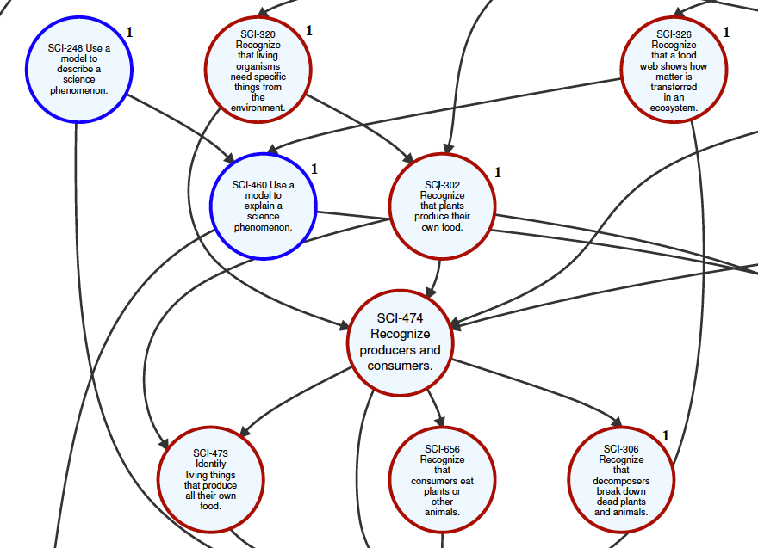
Map Model Segment from
Neighborhood EE.MS.LS2-2: Use models of food chains/webs to identify producers and consumers in
aquatic and terrestrial ecosystems.
Disciplinary Core Idea:
LS2.B Cycle of Matter and Energy Transfer in Ecosystems.
Science and Engineering Practice (Blue Circles):
Developing and using models

Slide 12
Map Development – Phases 1 & 2 (DLM)
7 neighborhoods
Development plan reviewed by DLM TAC
Multiple rounds of online, asynchronous review
Recruited reviewers from DLM Science States
Iterative refinement of review criteria

Slide 13
Map Development – Phase 3 (I-SMART)
11 neighborhoods - 7 from Phases 1 & 2, 4 new
Onsite panel review - July, 2017
Recruited reviewers from I-SMART partner states

Slide 14
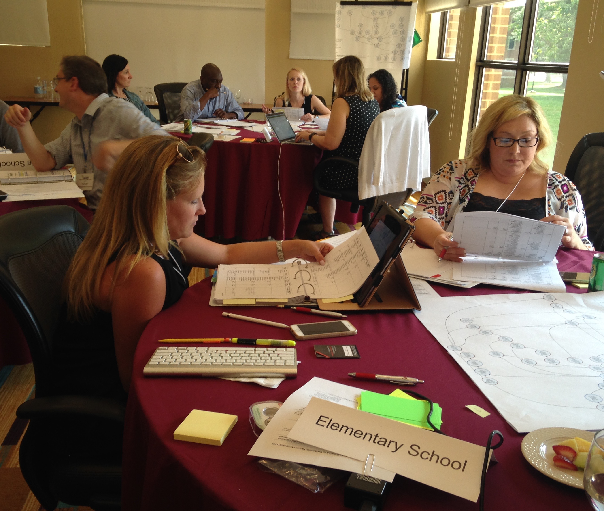
I-SMART Review Panel Process
One panel per grade span
3-4 neighborhood maps per panel
4 educators per panel (2 content- and 2 accessibility-focused)
Trained in advance and onsite

Slide 15
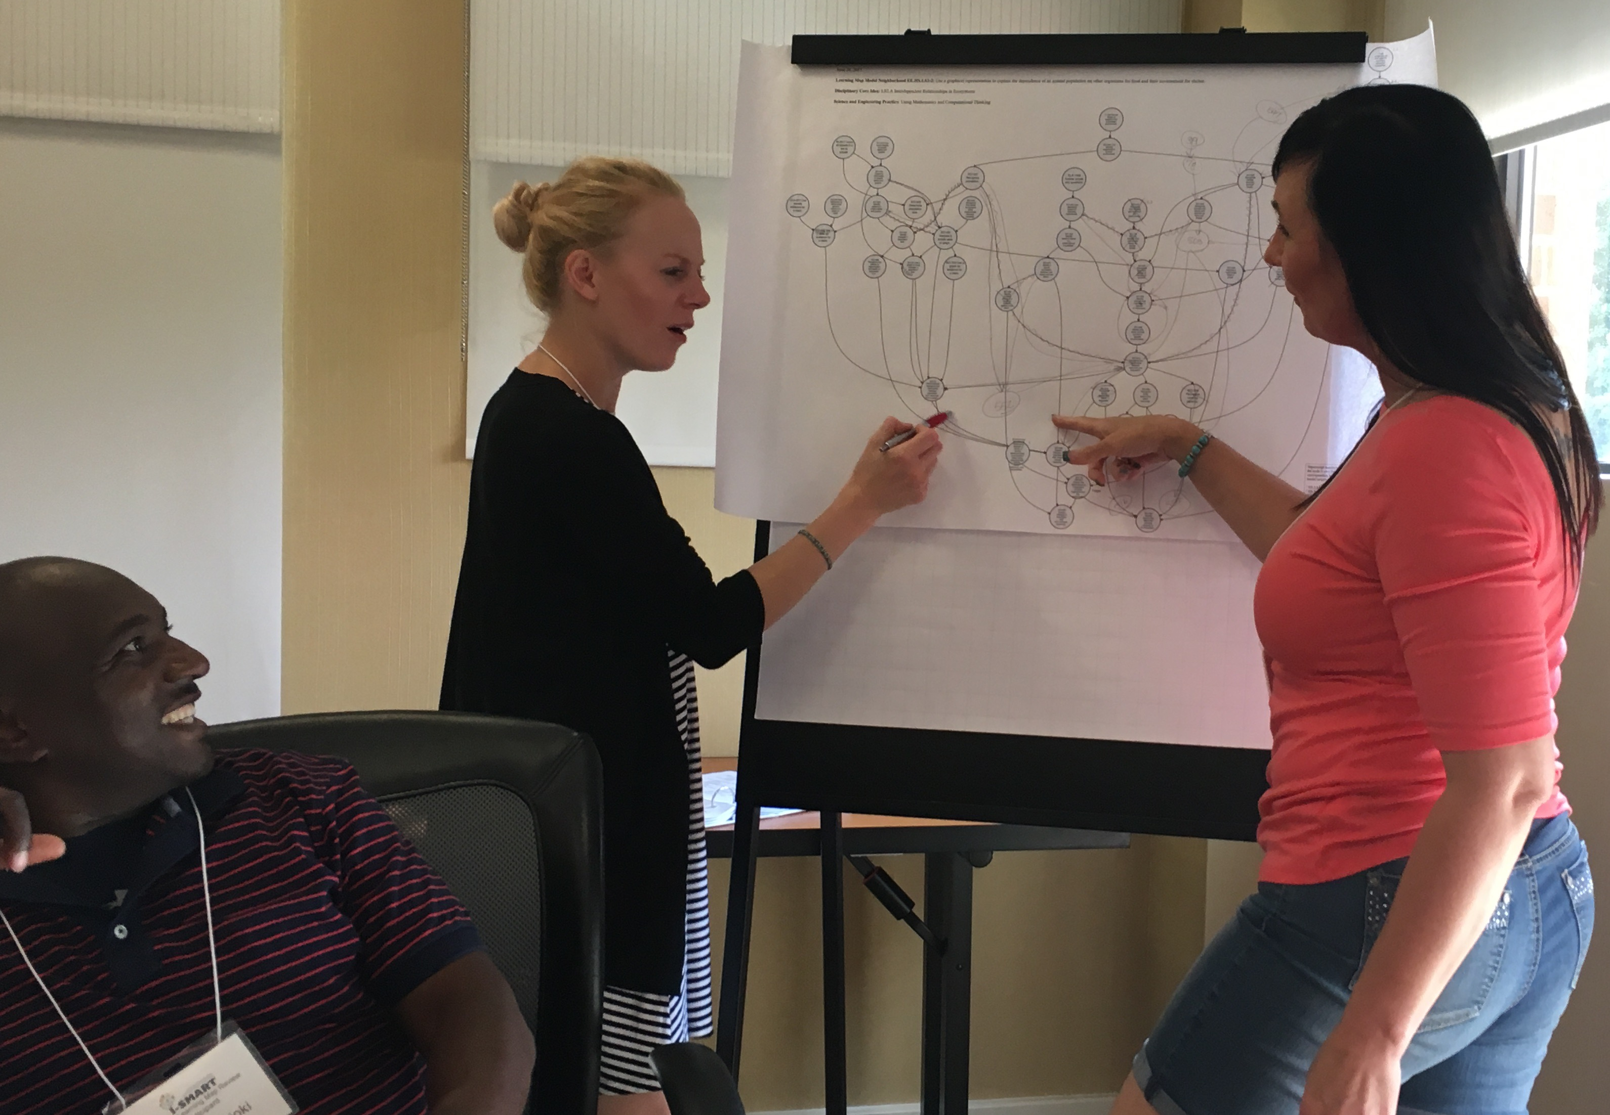
Panel Review Process - 4 Steps
Individual ratings
Table discussion and panel recommendations
Panel horizontal evaluation using ELA and math maps with an identification of a major pathway
Panel vertical relationships between science maps in the same DCI

Slide 16
Post-Panel Review Process
Step 1: Individual staff review
Review based on criteria:
Logic
Consistency with the neighborhood map
Consistency with the research narrative
Either accept panel recommendation or forward to step 2
Step 2: Group staff review
Discuss recommendations that did not meet the above criteria
May decide to accept, reject, or identify an alternative revision

Slide 17
Evaluation of Map Development
Internal evaluator
Staff observer
External evaluator
Focus group

Slide 18
Goal 2 Testlet Development Progress – Literature Review and Development Plan

Slide 19
Example of a Current DLM Science Testlet
Includes an engagement activity and items to assess student understanding of forces and motion.
Example Testlet Link

Slide 20
Testlet Design Literature Review
Staff queried academic search databases
Search terms such as: UDL, choice, motivation, engagement, accessibility in assessment, science instruction
Results synthesized and summarized

Slide 21
Testlet Development Next Steps
From the literature review and revised design framework, create prototype Essential Element Concept Maps, develop prototype testets, conduct cognitive labs, field-test testlets

Slide 22
Goal 3 Reporting Dashboard Progress - Needs Assessment and Focus Groups

Slide 23
Dashboards
Provide immediate access to student data in an accessible, attractive, and engaging way that facilitates comprehension, insight, and instructional design-making.

Slide 24
Focus-Group Design
Two focus groups of 4-5 teachers each
Virtual meetings
90 minute sessions of informal conversation, with guiding questions and examples of existing educational dashboards

Slide 25
Analysis
Analyzed according to 3 categories
What teachers expressed that they need in order to teach
Strategies and practices that teachers currently employ
What features teachers do / don’t desire from dashboards

Slide 26
Dashboard Design Ideas - Highlights
Expose teachers to the learning map models
Design to clearly indicate what has been assessed, mastered, or not mastered with a quick look
Carry-over teacher comments / recommendations from year to year
Provide links to each essential element to instructional resources

Slide 27
One idea.. Many more to come

Slide 28
Project Feedback from States and Advisors

Slide 29
Feedback from States and Advisors
Map model information originally designed for item writers could provide rich information for teachers (e.g. how each map node could be observed.)

Slide 30
Feedback from States and Advisors
Enhancements to testlets should be carefully considered; competing strengths and needs of student populations
We should look to lessons learned from other projects re: motivation, choice, UDL (PARA/NARAP, Science Notebooks)
We could focus on reporting and displaying clusters of nodes to prevent over-emphasis of any one node and support teachers in thinking across concepts and practices

Slide 31
Feedback from States and Advisors
The dashboard could help teachers’ assessment literacy, understanding of terms, what mastery is, etc.
The team should provide clear documentation for all products, including how testlet innovations / components are tied to design framework

Slide 32
Questions?

Slide 33
Contact Us…
ismart@ku.edu
ismart.works
785-864-7093
The contents of this presentation were developed under a grant from the Department of Education. However, those contents do not necessarily represent the policy of the Department of Education, and you should not assume endorsement by the Federal Government.

